Slide 1


Team Name : Bharat Brain Wave
Team Leader Name : Ritesh Raut
Problem Statement : AI for Retail, Commerce & Market Intelligence: Build an AI-powered solution that enhances decision-making, efficiency, or user experience across retail, commerce, and marketplace ecosystems.

Slide 2

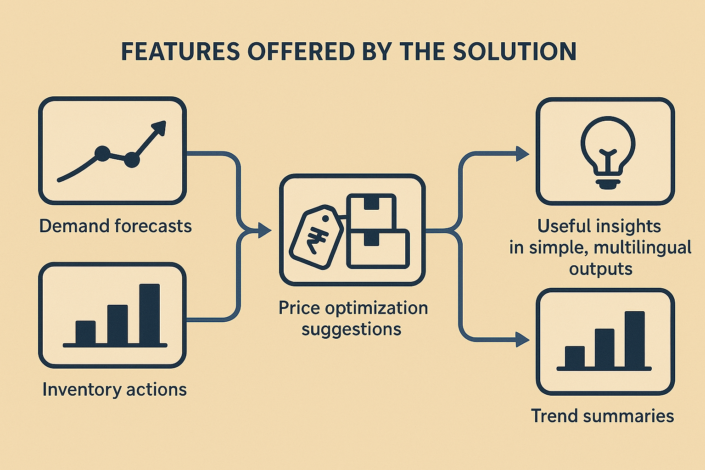
Brief about the Idea:
Solution Title: Merchant Intelligence Copilot for Indian MSMEs
Merchant Intelligence Copilot is an AI-powered decision assistant for Indian MSMEs and sellers.
It converts simple CSV / POS data into:
Demand forecasts
Price optimization suggestions
Inventory actions
Trend summaries
Useful insights in simple, multilingual outputs
Built using Amazon Bedrock, it delivers actionable recommendations, helping sellers reduce stockouts, avoid overstocking, improve margins, and adopt data-driven planning without complexity.

Slide 3

Explanation of the Solution
How is it different from existing ideas?
Designed specifically for Bharat MSMEs with low-data onboarding
Multilingual insights (English/Hindi/Marathi)
Explains “why” behind suggestions, not just graphs
Combines forecasting + LLM reasoning + actionable next steps
How will it solve the problem?
Forecast weekly/daily product demand
Suggest reorder quantities and highlight risks
Recommend optimal price bands based on market signals and margins
Generate simple action plans sellers can execute immediately
USP (Unique Selling Proposition)
Actionable Copilot, not just dashboards
Works with simple CSVs, no specialized software required
High interpretability with confidence scoring
Lightweight deployment — web app / API today, WhatsApp‑style later

Slide 4
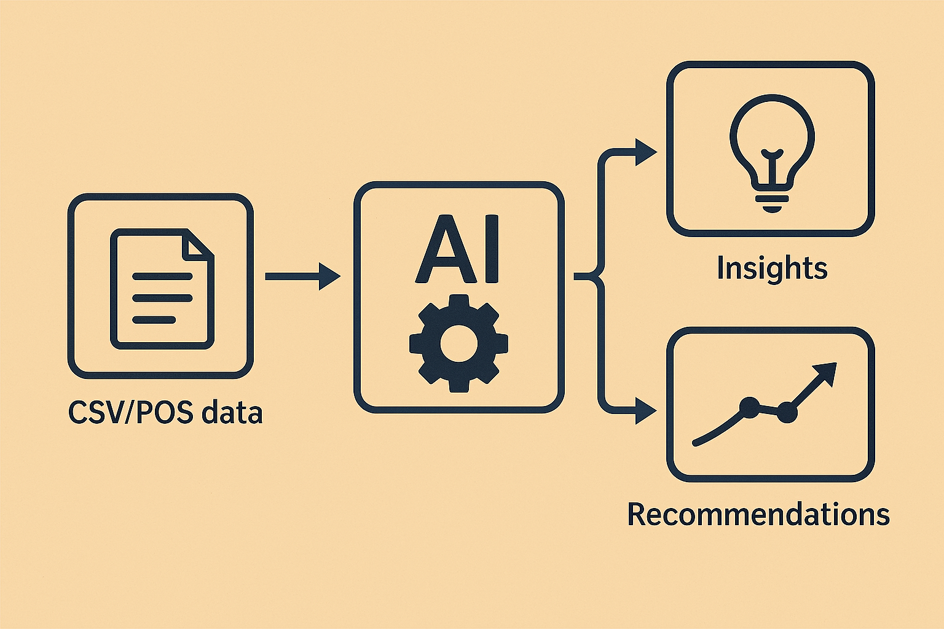
List of features offered by the solution
• Upload CSV/POS data (sales, inventory, pricing)
• Automated demand forecasting using seasonal patterns
• Reorder quantity recommendations
• Multilingual insights & explanations
• Price intelligence (margin-aware ranges)
• Trend summarizer (identify spikes/drops)
• Merchant Copilot Chat (Q&A + explanations)
• Alerts for stockout risk, slow movers, anomalies
• Auto-generated weekly action plans
• Shareable reports for store teams

Slide 5
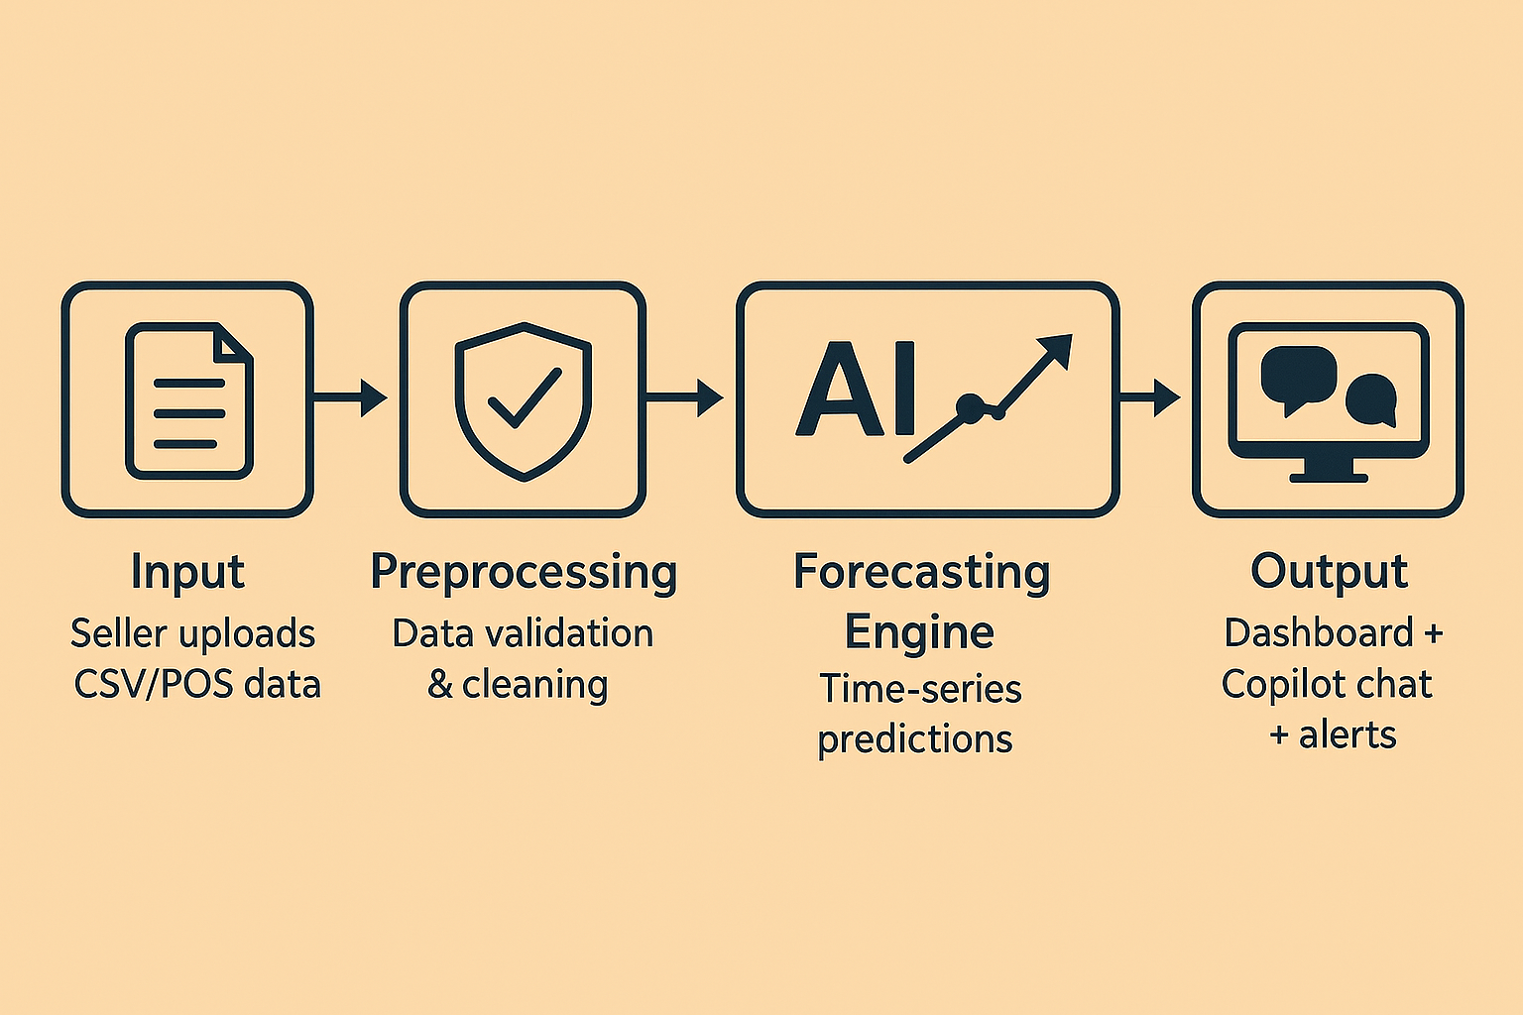
Process flow diagram or Use-case diagram
Process Flow:
Input: Seller uploads CSV/POS data
Preprocessing: Data validation & cleaning
Forecasting Engine: Time-series predictions
LLM Reasoning: Insights + “why” + action steps
Output: Dashboard + Copilot chat + alerts
Primary Use Cases:
“What should I stock for next week?”
“Which items are slow movers and why?”
“Suggest optimal price for Product X.”
“Give me a weekly action plan.”

Slide 6
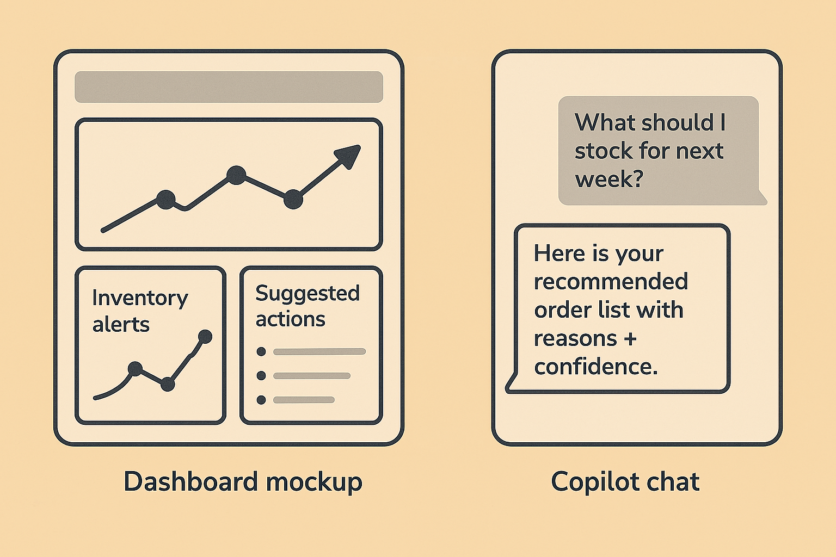
Wireframes/Mock diagrams of the proposed solution
Dashboard Mockup Includes:
Data upload section
Sales + forecast chart
Inventory alerts
Suggested actions
Copilot Chat Mockup Includes:
User: “What should I stock for next week?”
AI: “Here is your recommended order list with reasons + confidence.”

Slide 7
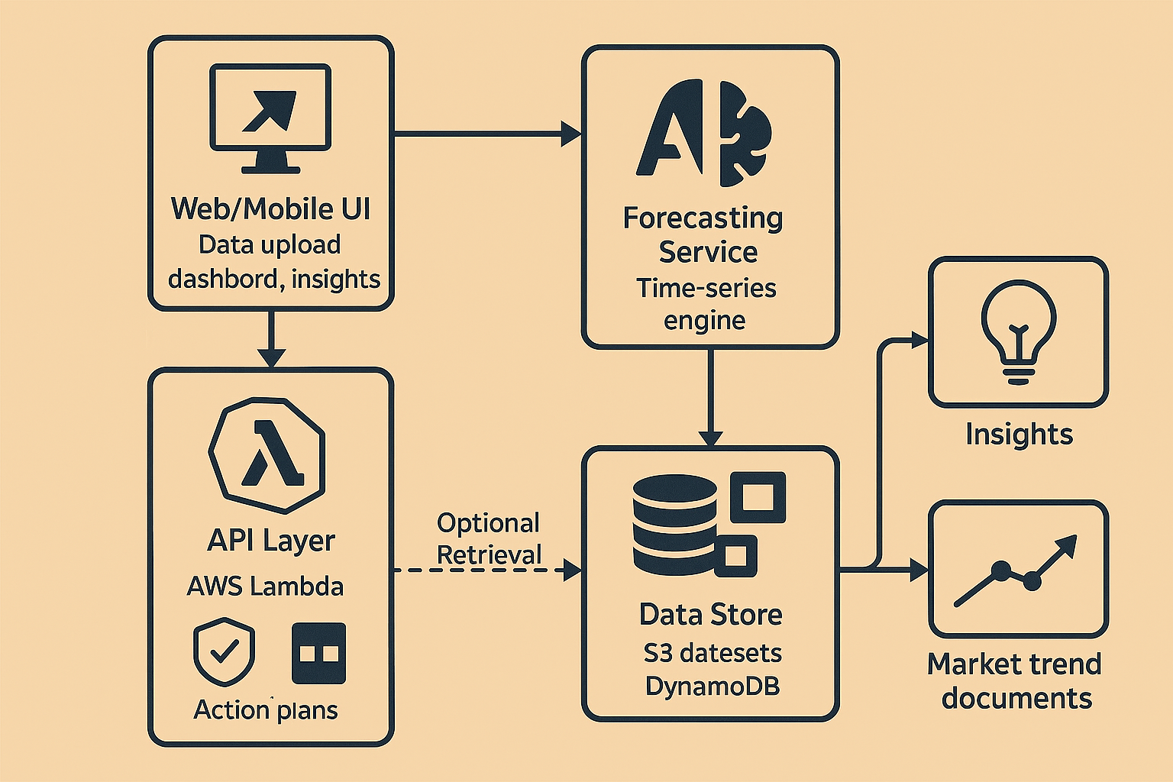
Architecture diagram of the proposed solution:
Components:
Web/Mobile UI: Data upload, dashboard, insights
API Layer: AWS Lambda + API Gateway
Forecasting Service: Time-series engine
Amazon Bedrock: LLM for summaries, reasoning, action plans
Data Store: S3 for datasets, DynamoDB for metadata
Optional Retrieval: Market trend documents

Slide 8
Technologies to be used in the solution:
Amazon Bedrock — LLM reasoning, insights, summarization
AWS Lambda + API Gateway — Backend services
Amazon S3 — Data storage
DynamoDB — Metadata storage
Forecasting — Python time-series model
Frontend — React / Next.js or Streamlit for prototype
CI/CD — GitHub
Responsible AI: Input filtering, disclaimers, confidence scoring

Slide 9
Estimated implementation cost :
Prototype Assumptions:
1 merchant
100 LLM queries/day
Small CSV uploads
Estimated Monthly Cost:
• Bedrock inference: ₹1,500 – ₹6,000
• S3 + Lambda + API Gateway: ₹300 – ₹1,200
Total: ₹1,800 – ₹7,200 / month
Cost Optimizations:
Cache repeated insights
Use smaller models for routine tasks
Limit context window

Slide 10
Additional requirements or checklists for the hackathon:
Submission Readiness:
• Meaningful AI usage (forecasting + LLM reasoning)
• Clear “Why AI?” explanation
• Simple & usable UI
• Responsible AI: confidence, safety, disclaimers
• Deliverables planned:
– GitHub repo
– 3‑min demo video
– AWS Builder Center blog
– Submission deck
Success Metrics:
• Reduce stockouts by 10–20%
• Reduce slow-moving inventory by 5–15%
• Improve margins by 1–3%

Slide 11

Team: Bharat Brain Wave | Lead: Ritesh Raut | Solution: Merchant Intelligence Copilot

